Slide 1
T01
Synthesizer Glove
Steve Peirce
Nicholas Sayre
Nathan Bryant
Ali Alavi

Slide 2
Notes:
Need: Have fun making music on the go
-wearable
-intuitive interface.
-can be played anywhere

Slide 3
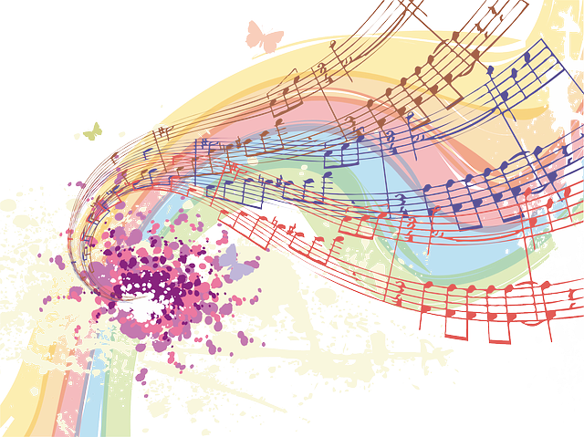
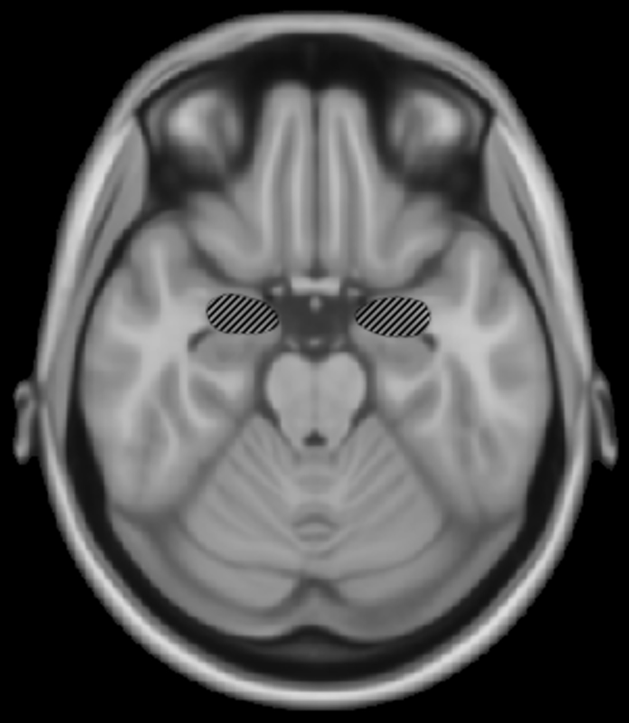
Motive
Notes:
Motivation: To promote a healthier lifestyle by reducing stress while stimulating the brain.
MUSIC
-music is used for therapy and helps reduce stress
-increases creativity

Slide 4
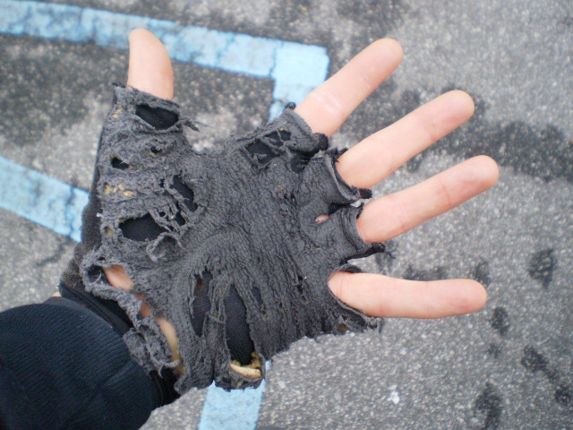
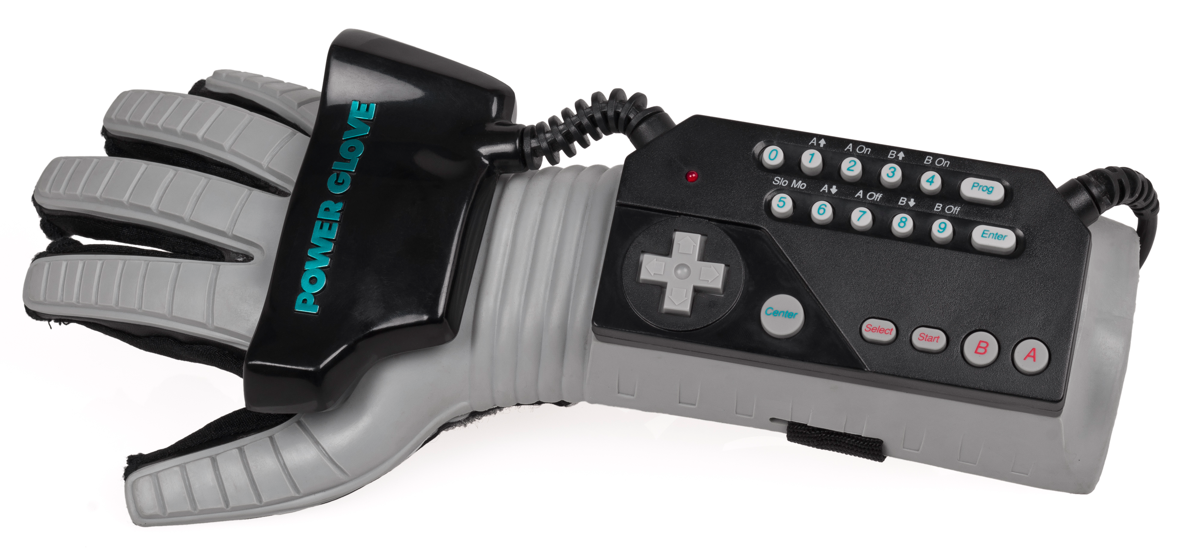
Goal
Notes:
Goal: to create a functional proof of concept which could later be adjusted by marketing for best visual design.
-wanted our prototype to function well
-how pretty the design is wasn’t a concern to us

Slide 5
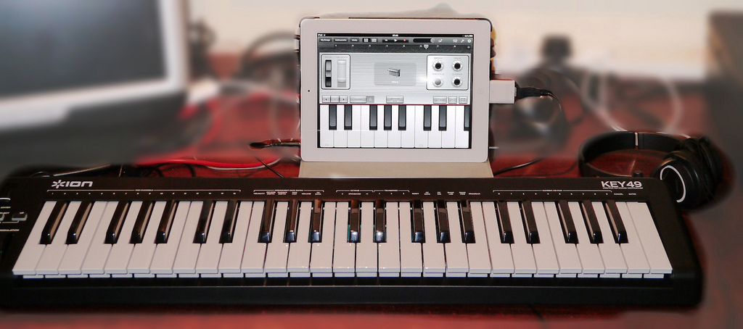
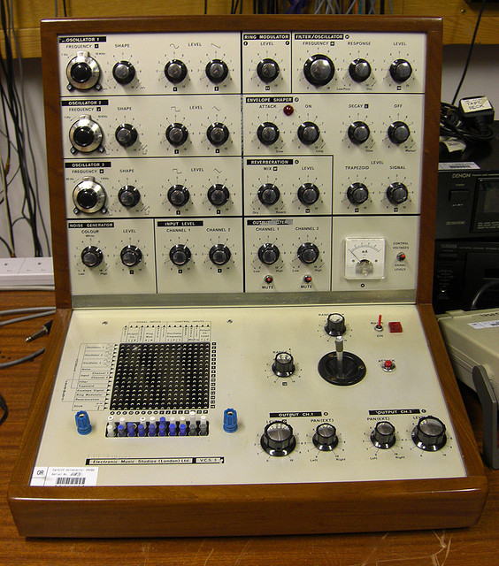
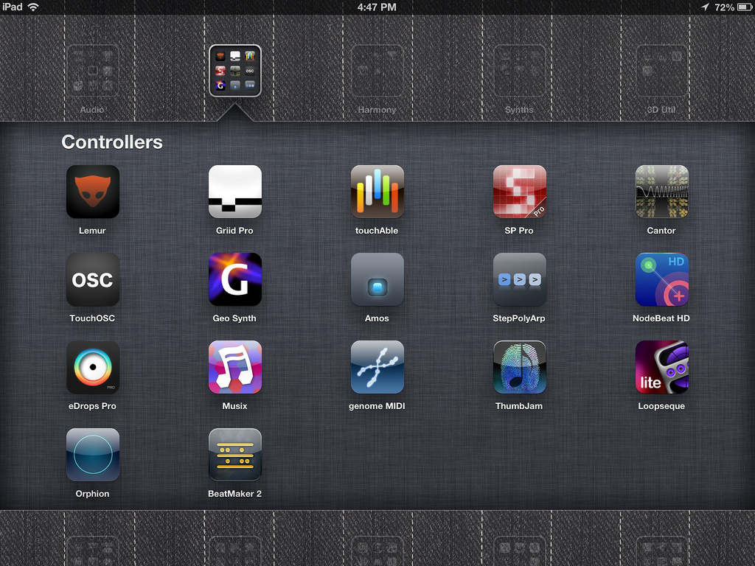
Alternatives
Notes:
Alternatives: While many nonconventional music instruments exist, most keyboards require the user to play in one place or at a station.
-examples:
Phone/Tablet apps are close but are not as intuitive and mainly just simulate other instruments
- None as versatile

Slide 6
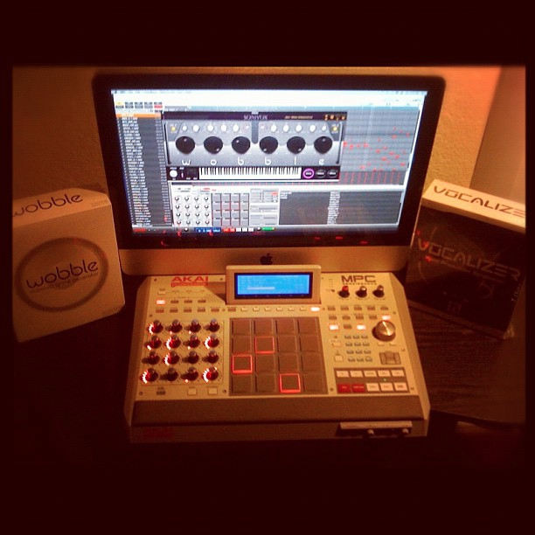
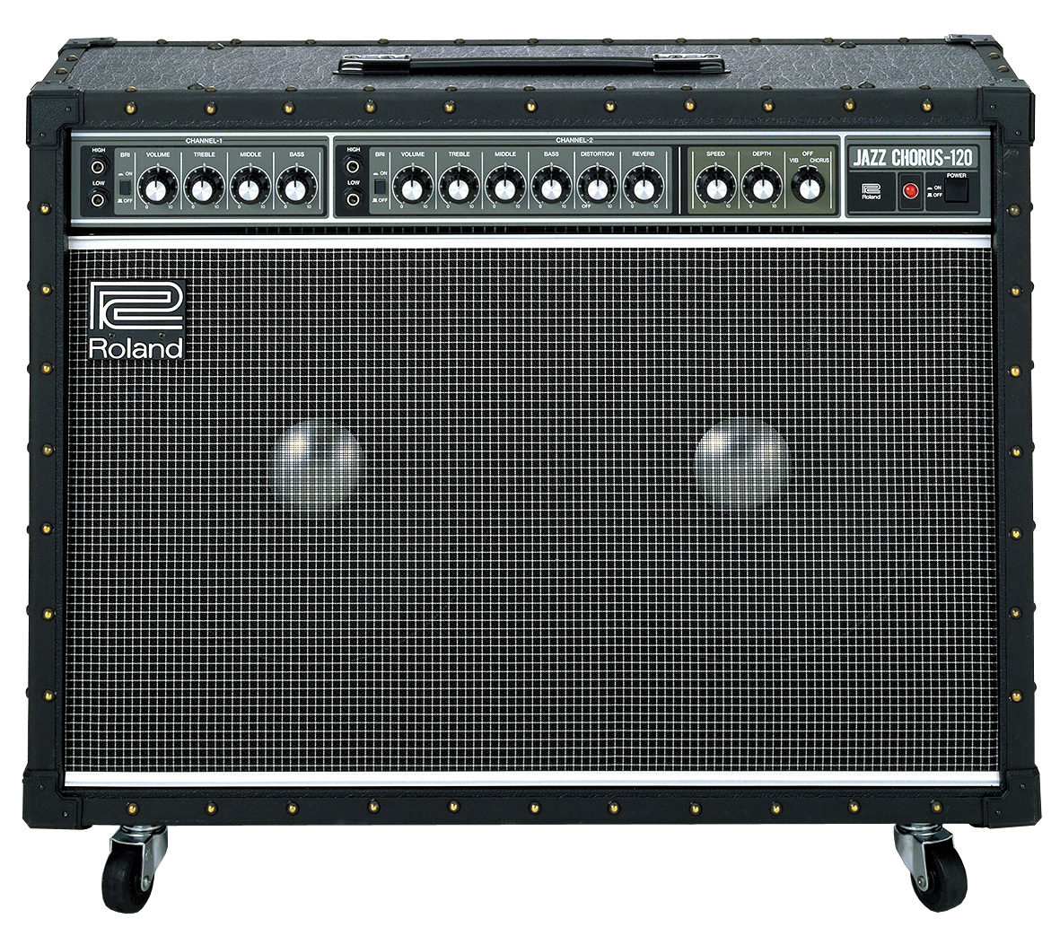
Approach
Notes:
Approach: We aimed to combine the musical versatility of a keyboard with freedom of movement while creating a new experience that inspires creativity.
Avoid bulky equipment
One single unit
Intuitive interface: what’s more intuitive than finger movement?
Wearable and easy to transport, thus glove.

Slide 7
Requirements
System will be capable of altering the produced tones based on the status of at least two sensors.
System will be battery powered and have power consumption of approximately 2.5 watts.
The system will use an inexpensive cost microcontroller to produce low resolution sounds.
System will be capable of producing tones based on finger contact.
System will be capable of producing a minimum of 5 frequencies.
System must be wearable on users hand or forearm.
Notes:
Given the focus of our project, deciding requirements were closely tied to how we conceived the physical design.
Design requirements doc here.
Justifications
finger contact:
Tone generation by finger contact is intuitive and typical for musical instruments.
2) 5 freq:
With one frequency per finger, this provides a unique frequency for each fingertip.
3) Alter tones:
Sensors like knobs, sliders, and buttons are intuitive, easy to use, and increase perception of value.
4) micro-controller:
Most low cost microcontrollers do not have analogue outputs so producing 1-bit sound as a base prevents undue reduction to development budget.
5) wearable:
Placing the system on an arm makes it accessible, portable, and easy to use.
6) power:
This makes the system loud enough to enjoy while still offering longer battery discharge times.

Slide 8
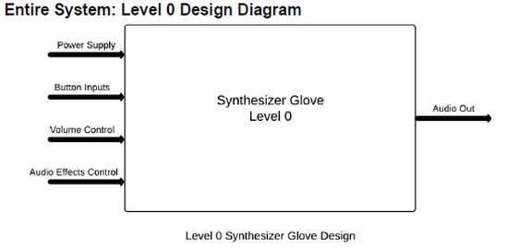
Design
Level 0
Notes:
Based on our agreed upon Requirements we concieved the system as:
UML 0
● Power: 9V DC battery
● Button inputs: Normally open momentary contact switches
● Volume control: Variable volume control
● Pitch/ tone: Variable pitch and tone control potentiometer
● Audio output: 0­9V audio signal
● Produce audio tones based on button and volume/pitch/tone control.
● Tones should be variable based on button status and audio quality should be
variable on volume/pitch/tone control status.

Slide 9
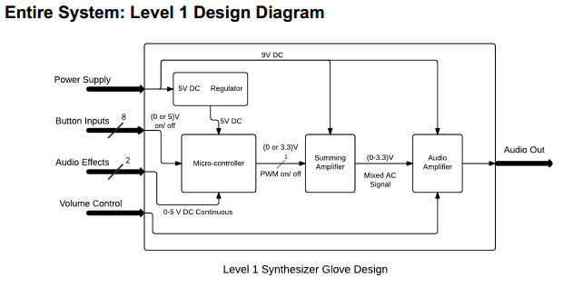
Design
Level 1
Notes:
-----------------REGULATOR--------------
Inputs:
● Power Supply: 9V battery
Output:
● DC Out: Regulated 5V DC signal
Functionality:
● The input signal enters a 9 to 5 V linear DC to DC voltage regulator.
● The signal is then smoothed using a capacitor >= 10µF.
● The signal is then filtered through a passive RC low­pass filter.
-----------------MICROCONTROLLER------------
Inputs:
● Digital 5V High: 8 total digital signals with a 5V logic high. 3 signals from the
vambrace control unit, and 5 signals from the push buttons in the glove.
● 0­5V Analog: 2 analog signals ranging from 0 to 5 volts from the vambrace control
unit.
● Regulated 5V DC: Regulated 5V DC voltage from the voltage regulator block for
power.
Output:
● PWM Digital Out: 5 total pulse width modulated signals outputting to the summing
amplifier.
Functionality:
● Produce one or two simultaneous pulse width modulated tones (PWM) based on
programmed glove button pushes.
● Shift tones to the next scale up or down, programmatically assigned to the buttons
on vambrace unit.
● Read two individual analog voltages based on a two axis joystick. One voltage will
shift the programmed PWM tones up and down by pitch, and the other by tone.
----------------AMPLIFIER----------------
Inputs:
● Slider Position: The output of a slider potentiometer controlling the output gain of
the amplifier.
● 0­3.3V Mixed AC: The 0­3.3V mixed AC output of the summing amplifier.
● 9V DC: 9V DC output of the battery for power.
Output:
● Audio Out: An amplified 0­3.3V PWM mixed AC signal.
Functionality:
● Amplifies the 0­3.3 V PWM tones produced by the microcontroller and added
together by the summing amp based on the position of the slider potentiometer.
--------------SUM AMP----------------
Inputs:
● 9V DC: 9V DC output of the battery for power.
● PWM 0­3.3V Digital: up to six 0­3.3V PWM tones generated by the microcontroller.
Output:
● 0­3.3V Mixed AC: 0­3.3V mix of two PWM tones.
Functionality:
● Outputs the sum of the first two generated PWM tones produced by the
microcontroller. Only two tones can be played simultaneously.

Slide 10
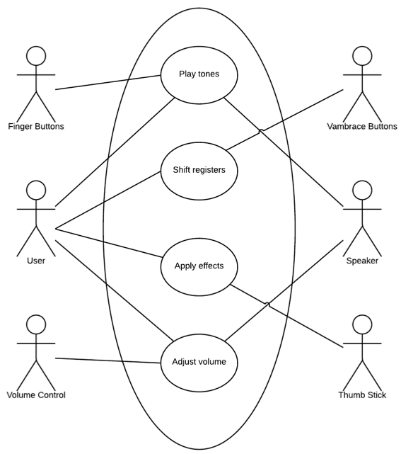
Design
Level 1
Notes:
------------Play Tones---------------
Actors: User, Finger Buttons, Speaker
Description: User makes music with right hand playing “piano” style, in
glove.
Stimulus: User presses finger(s) onto a hard surface, forcing
momentary switch at finger tip to make contact.
Response: Speaker produces multiple, scaled, PWM tones in real time corresponding to button pushes and ends tone in real time corresponding to button release.

Slide 11
Notes:
The interaction of button to sound was to be determined by software which meants the microcontroller was the centerpiece
Schematic 1
After finding out parts list we created the modified version and began board layour which lead to
Board + Schem

Slide 12
Notes:
Testing proved to be problematic. Pressure on team members and sequence of returns limited our ability to integration testing.

Slide 13
Notes:
Intellectual property → Rc ladder, Arduino, synth
→ 555 ladder + midi
→ ended up doing it our own way

Slide 14
Notes:
Contributions:
- What did each person contribute?

Slide 15
Notes:
Lessons Learned:
What did we all learn?
What would you do differently?

Slide 16
Notes:
Q/A

